Slide 2
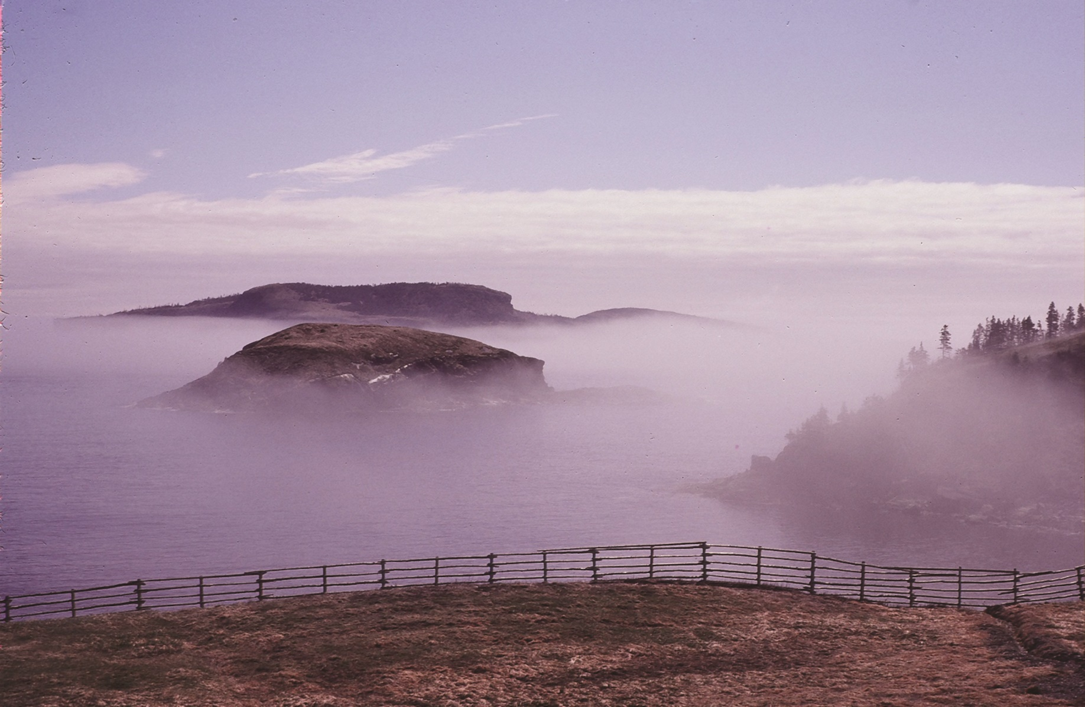
Patricia Grattan
Past Director / Chief Curator
Art Gallery of Newfoundland

Slide 3
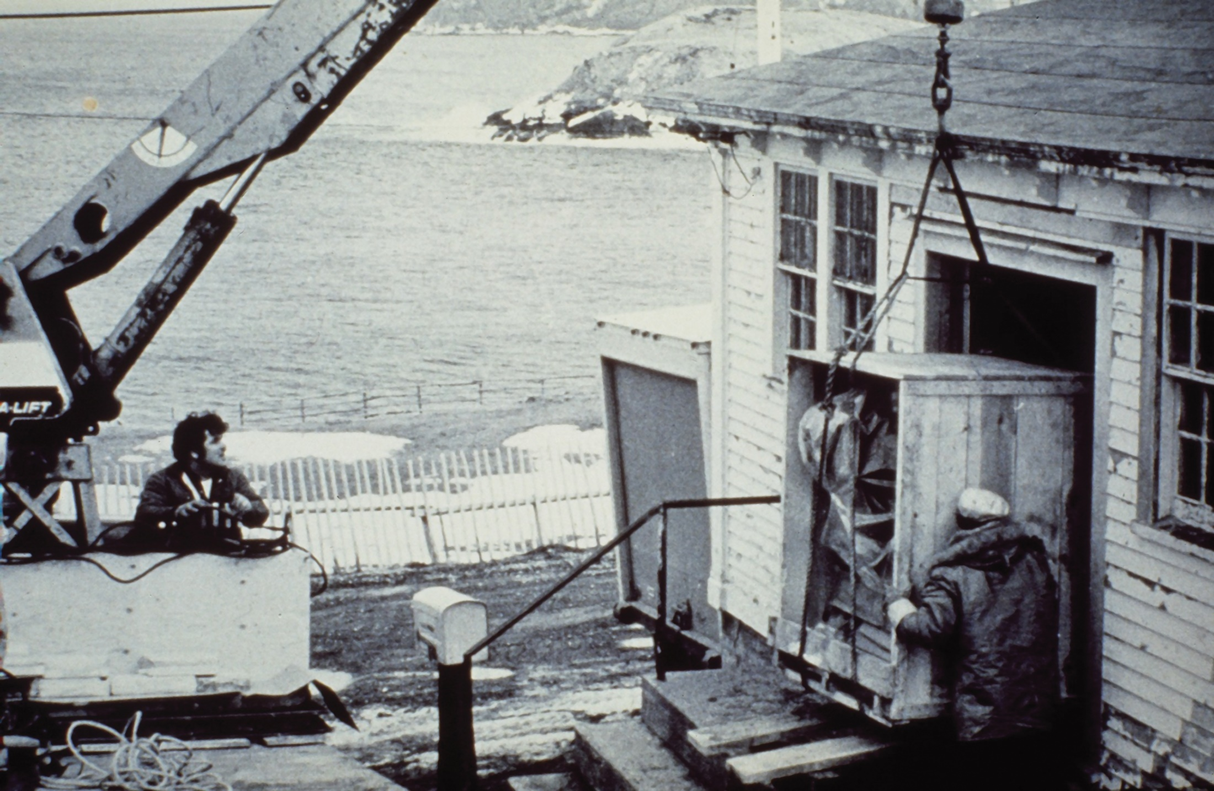

Slide 4
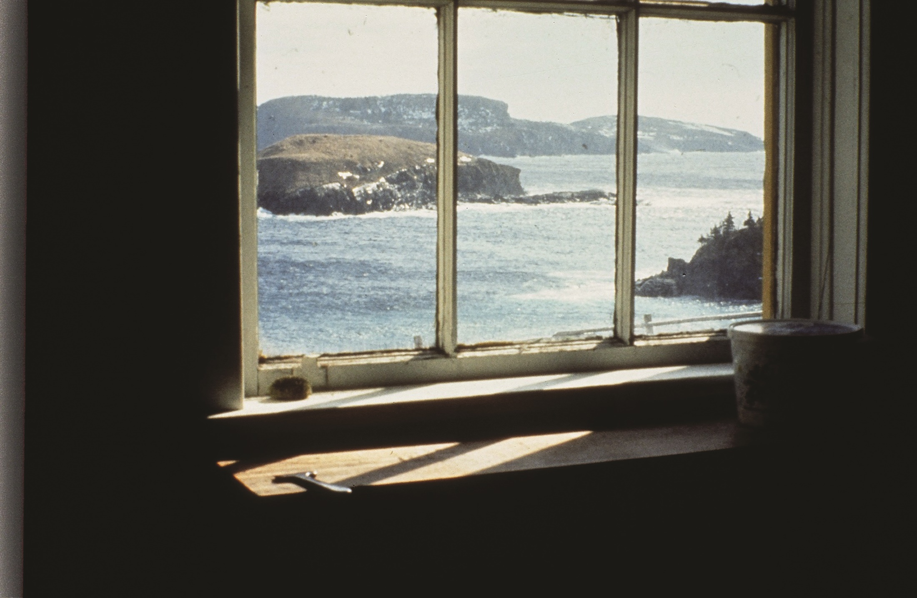

Slide 5
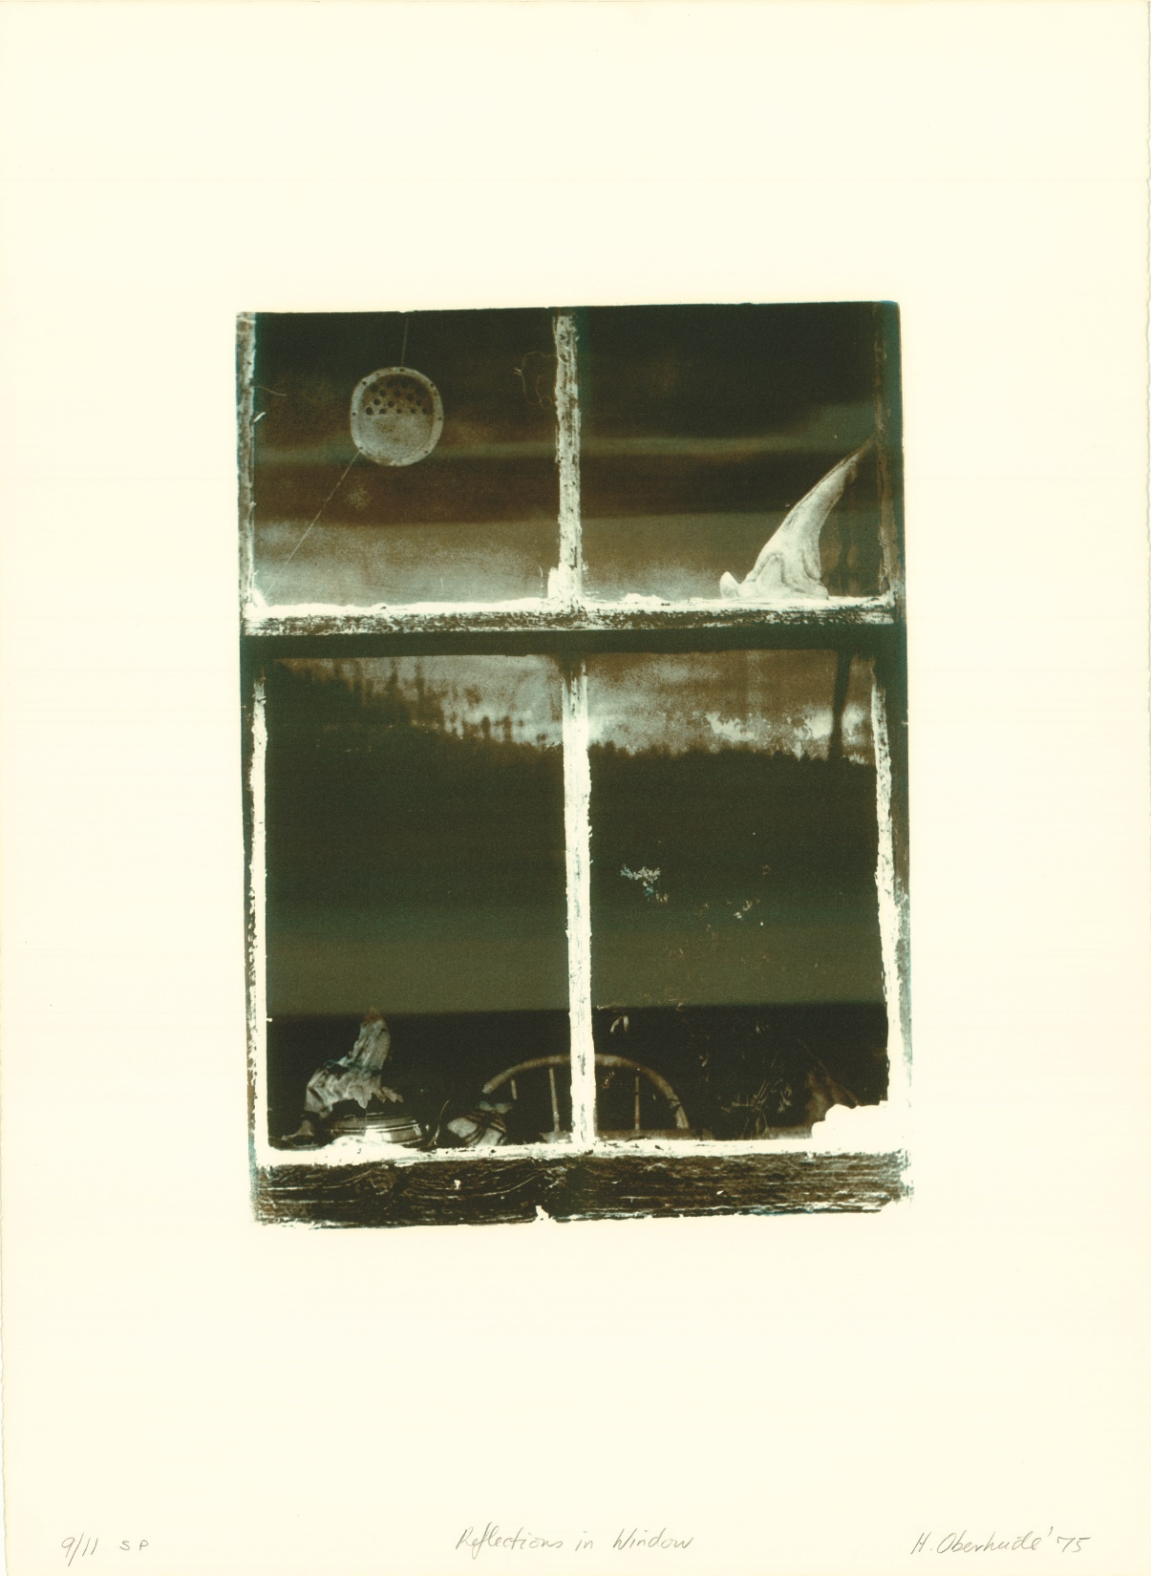

Slide 6
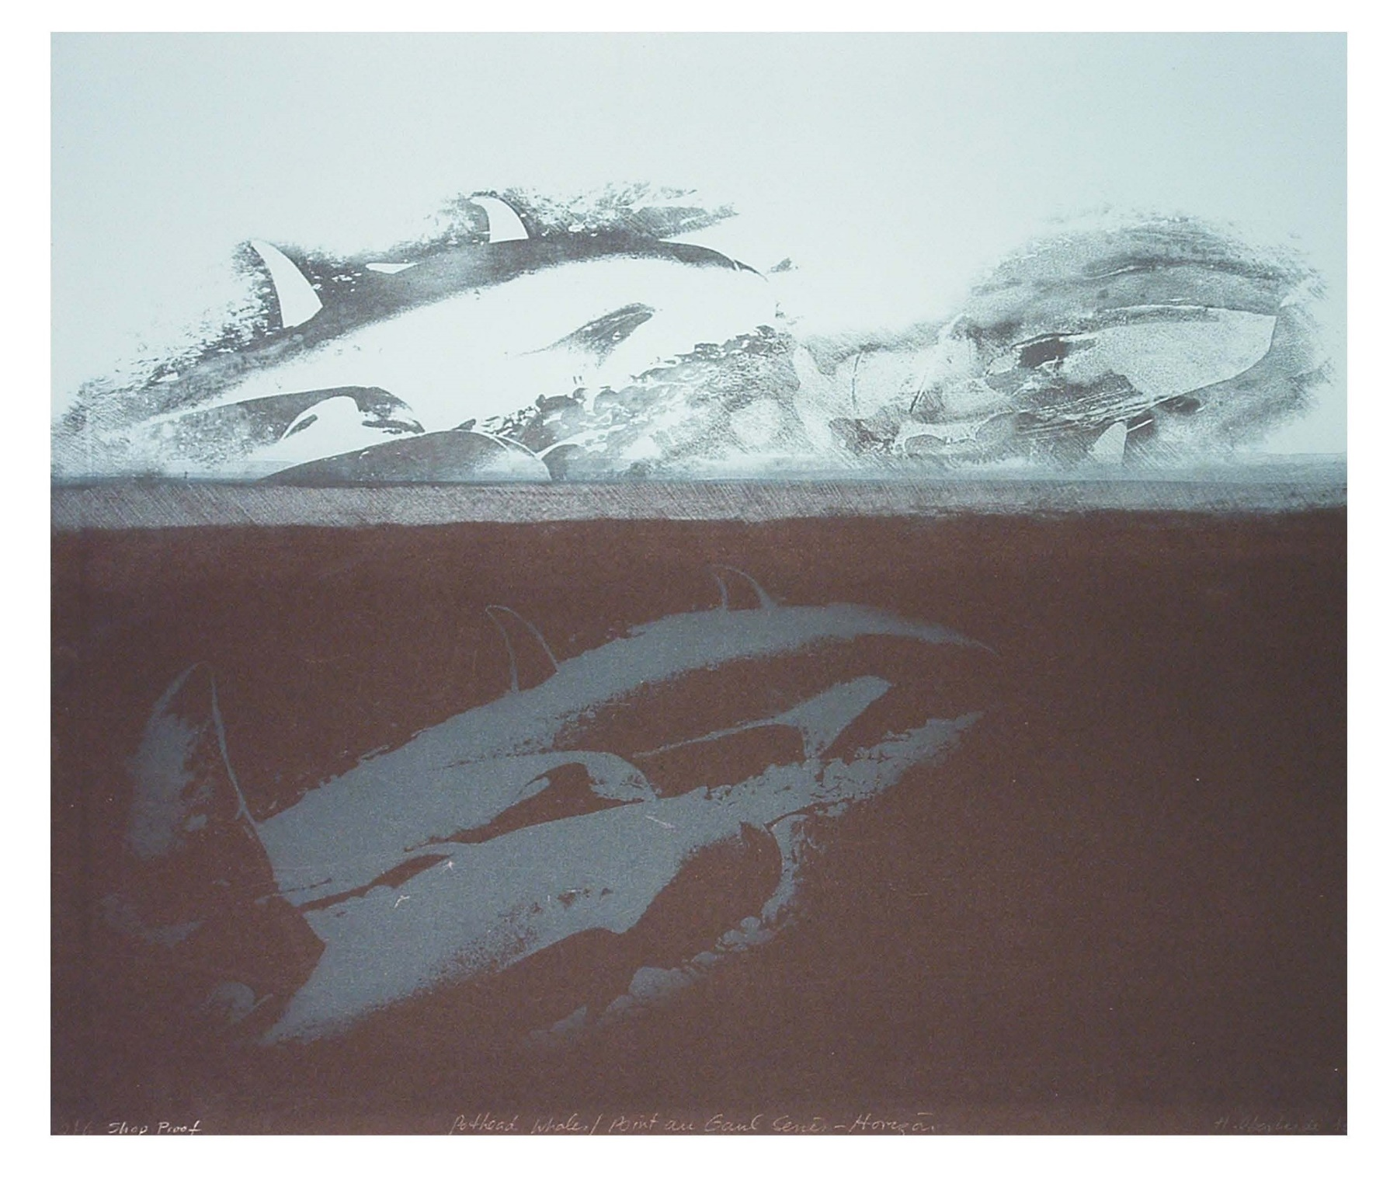

Slide 7
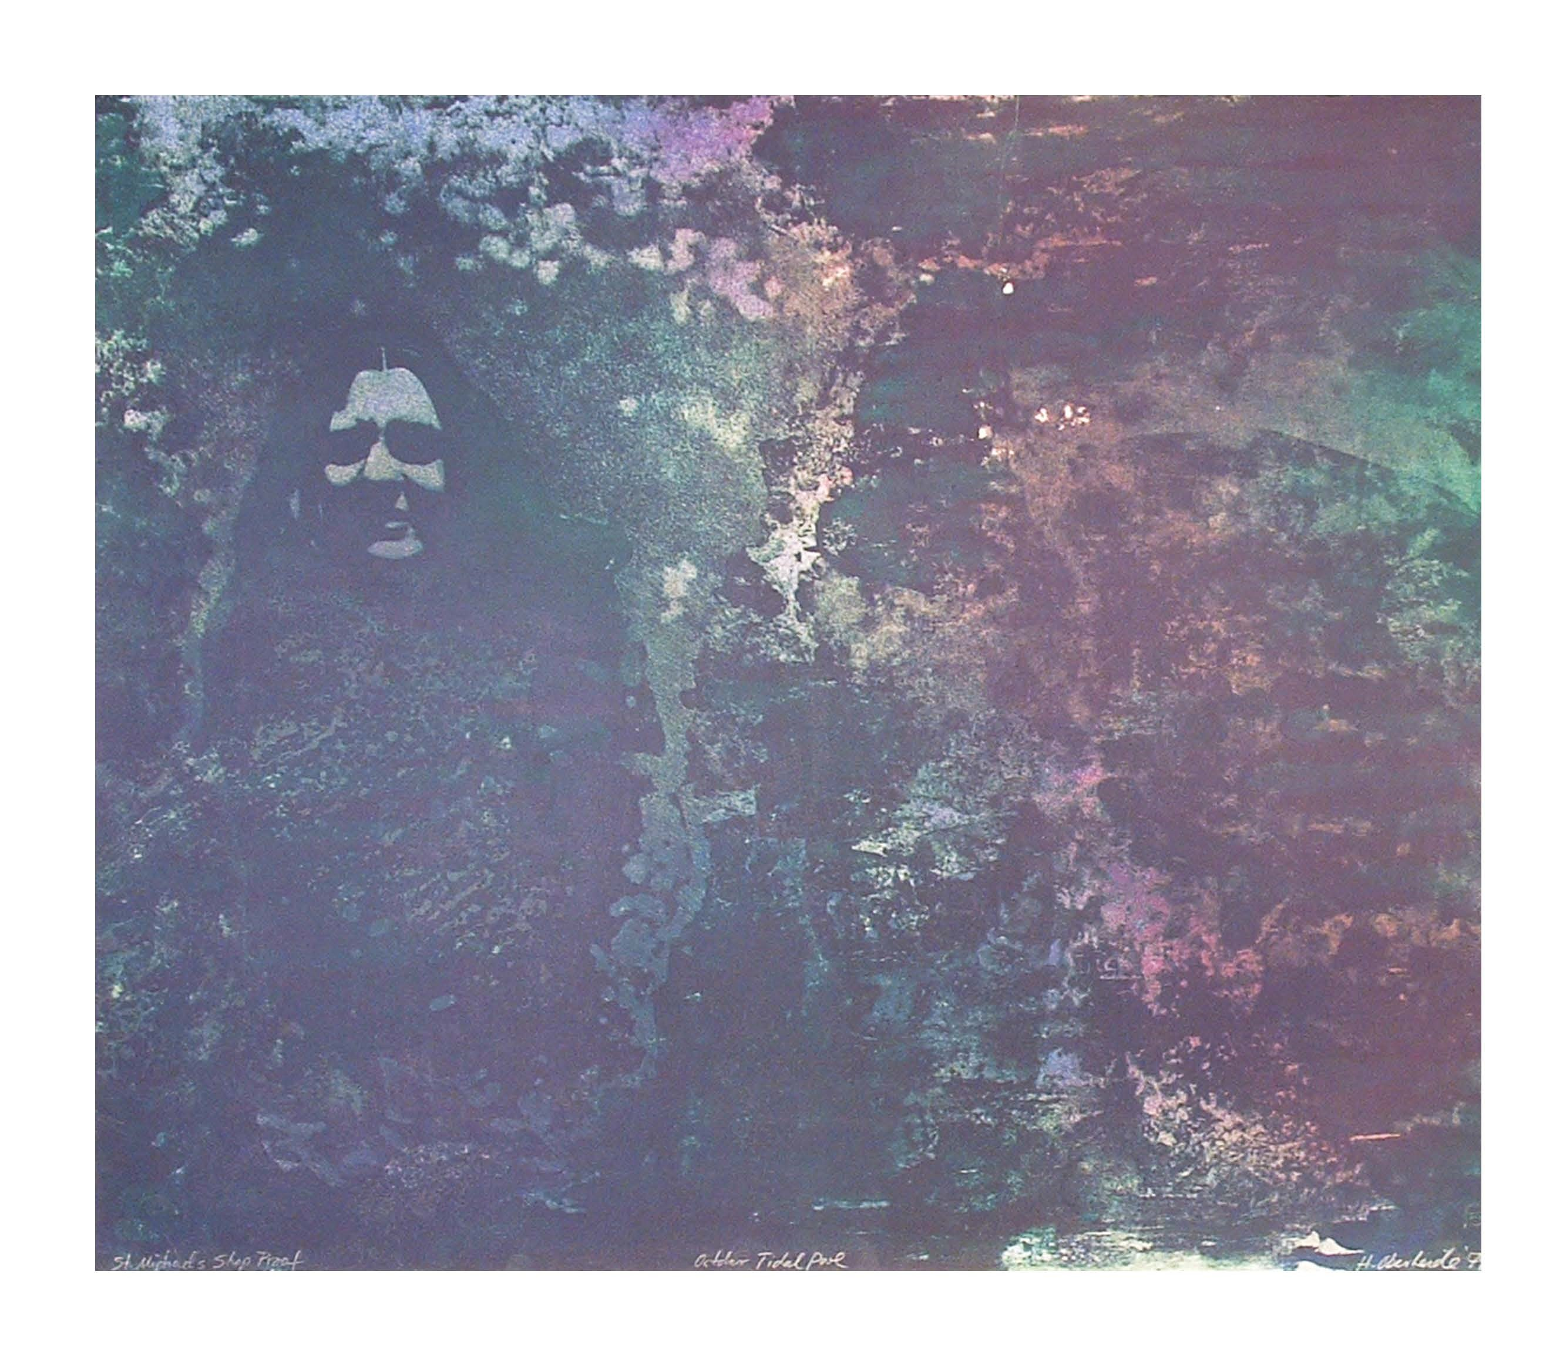

Slide 8
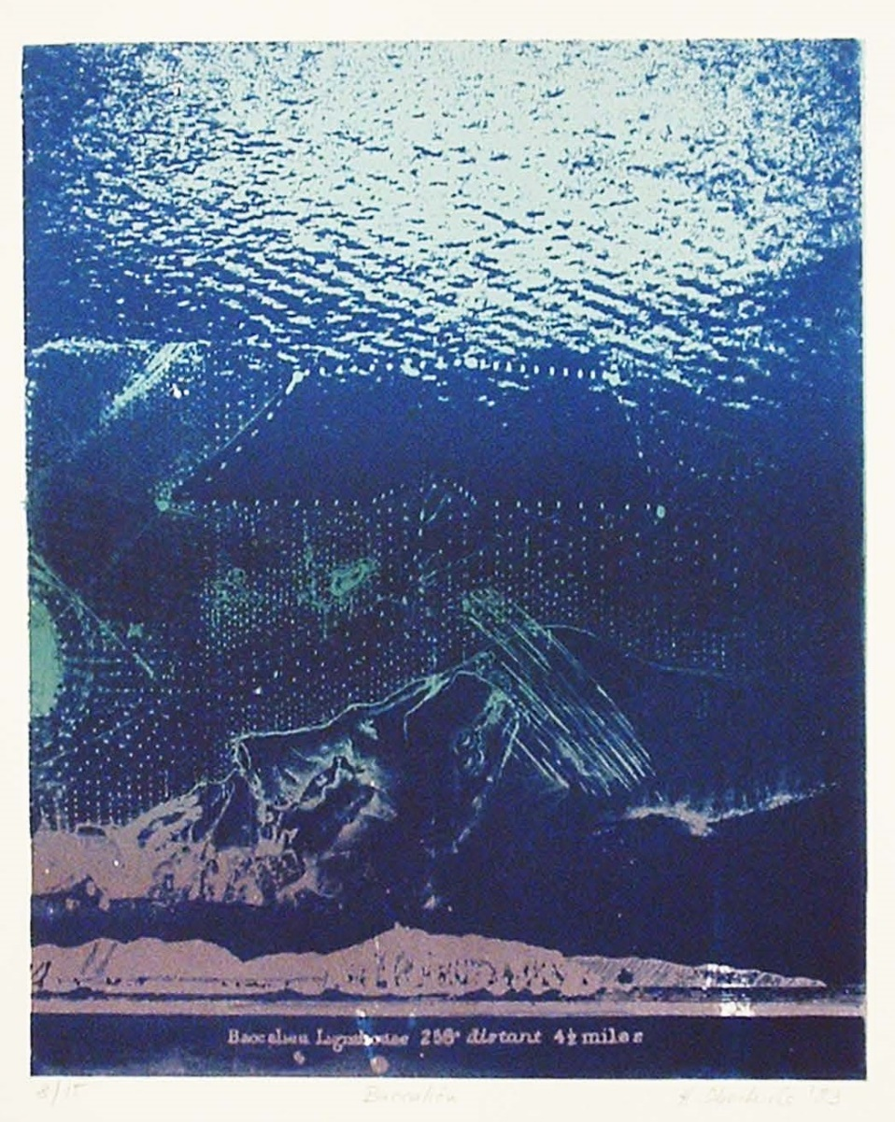

Slide 9
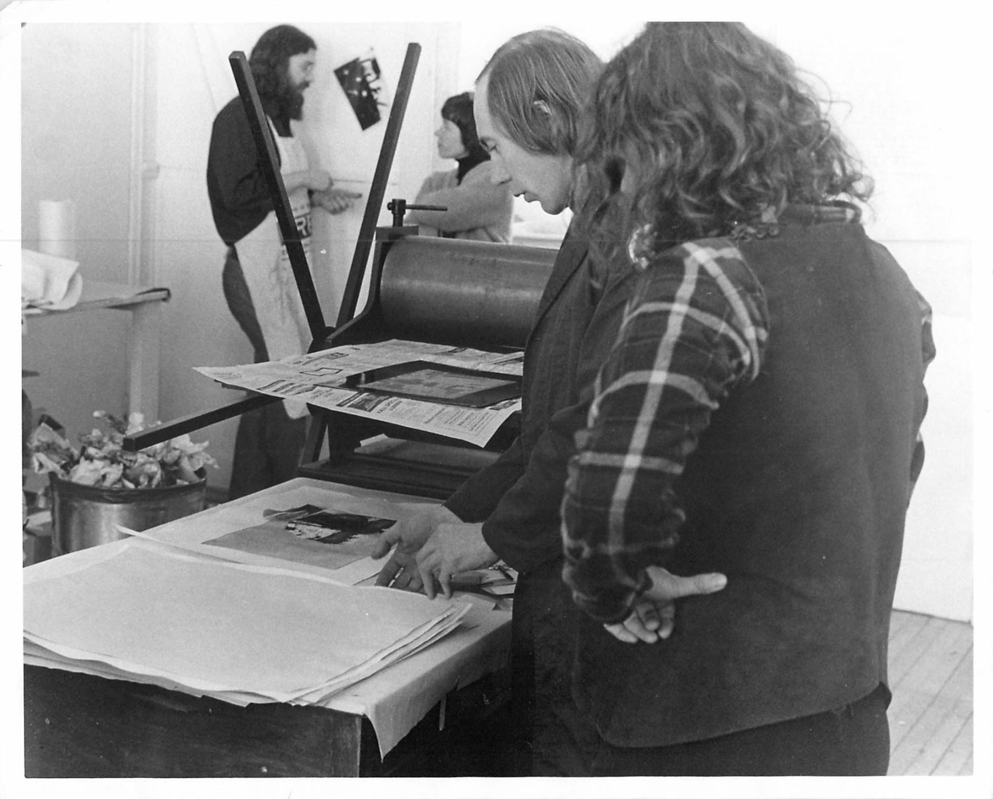
Frank Lapointe and Heidi

Slide 10
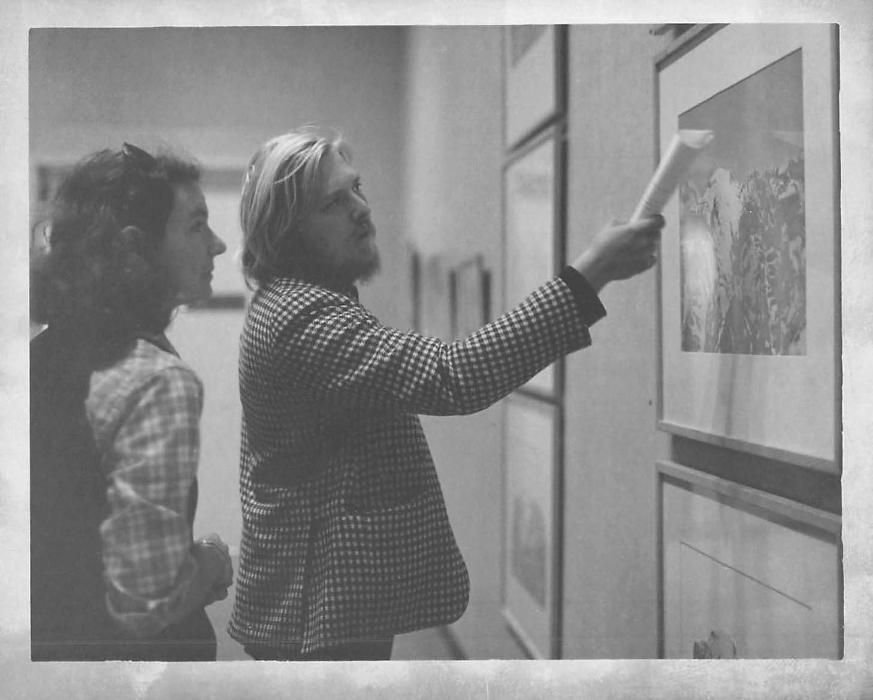
Heidi and master printer Don Holman

Slide 11
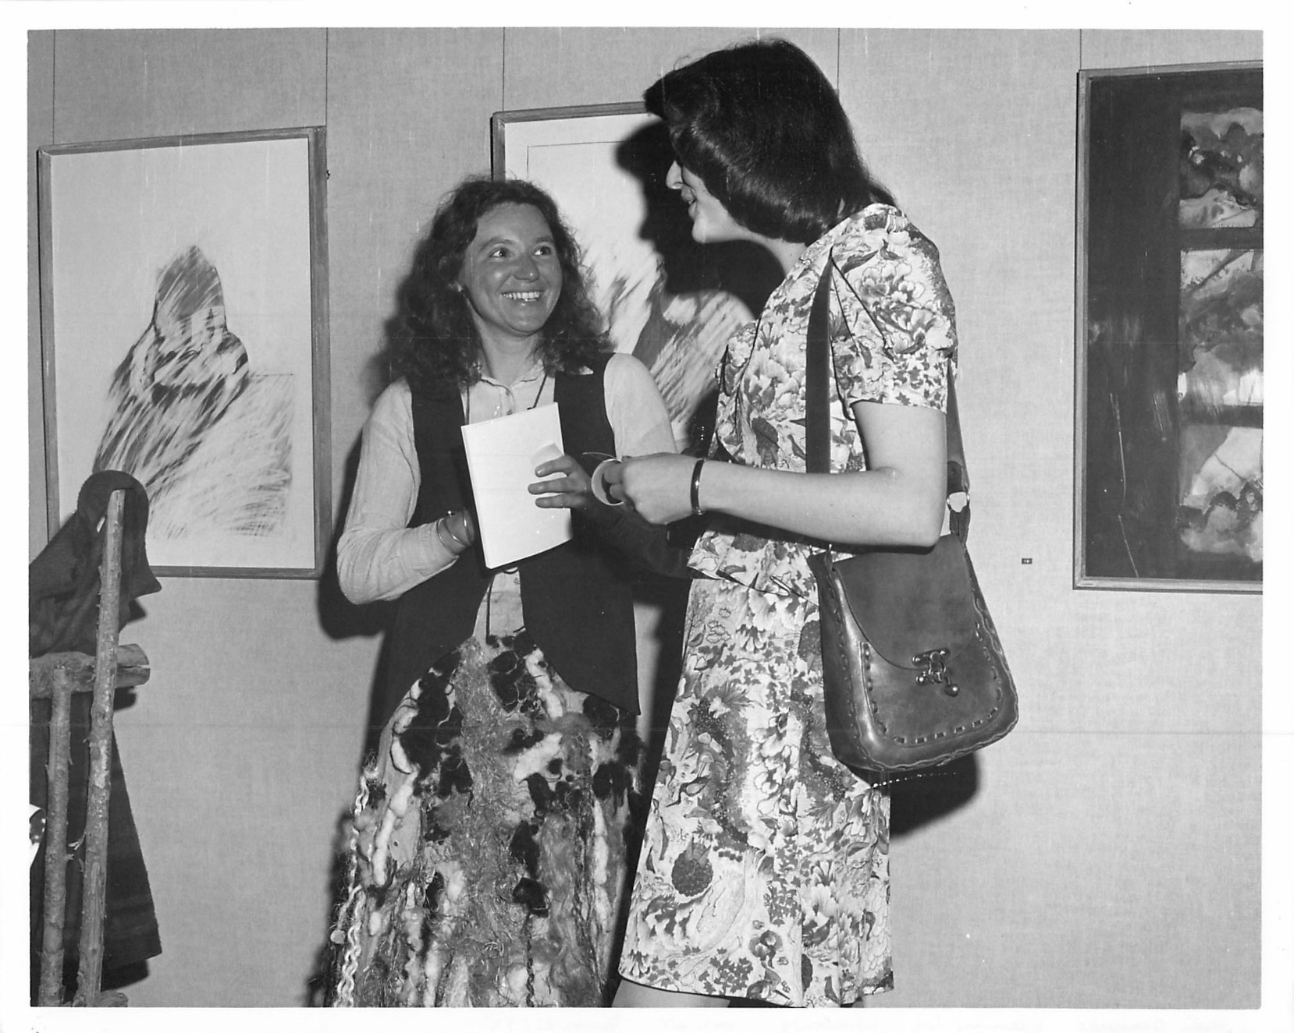
Heidi at Art Gallery Exhibition Opening

Slide 12
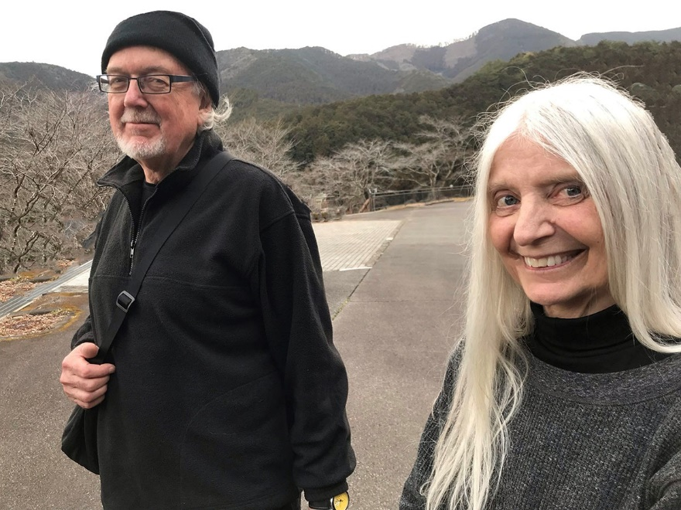
Derek Besant & Alexandra Haeseker
Artists-in-Residence 1977

Slide 13
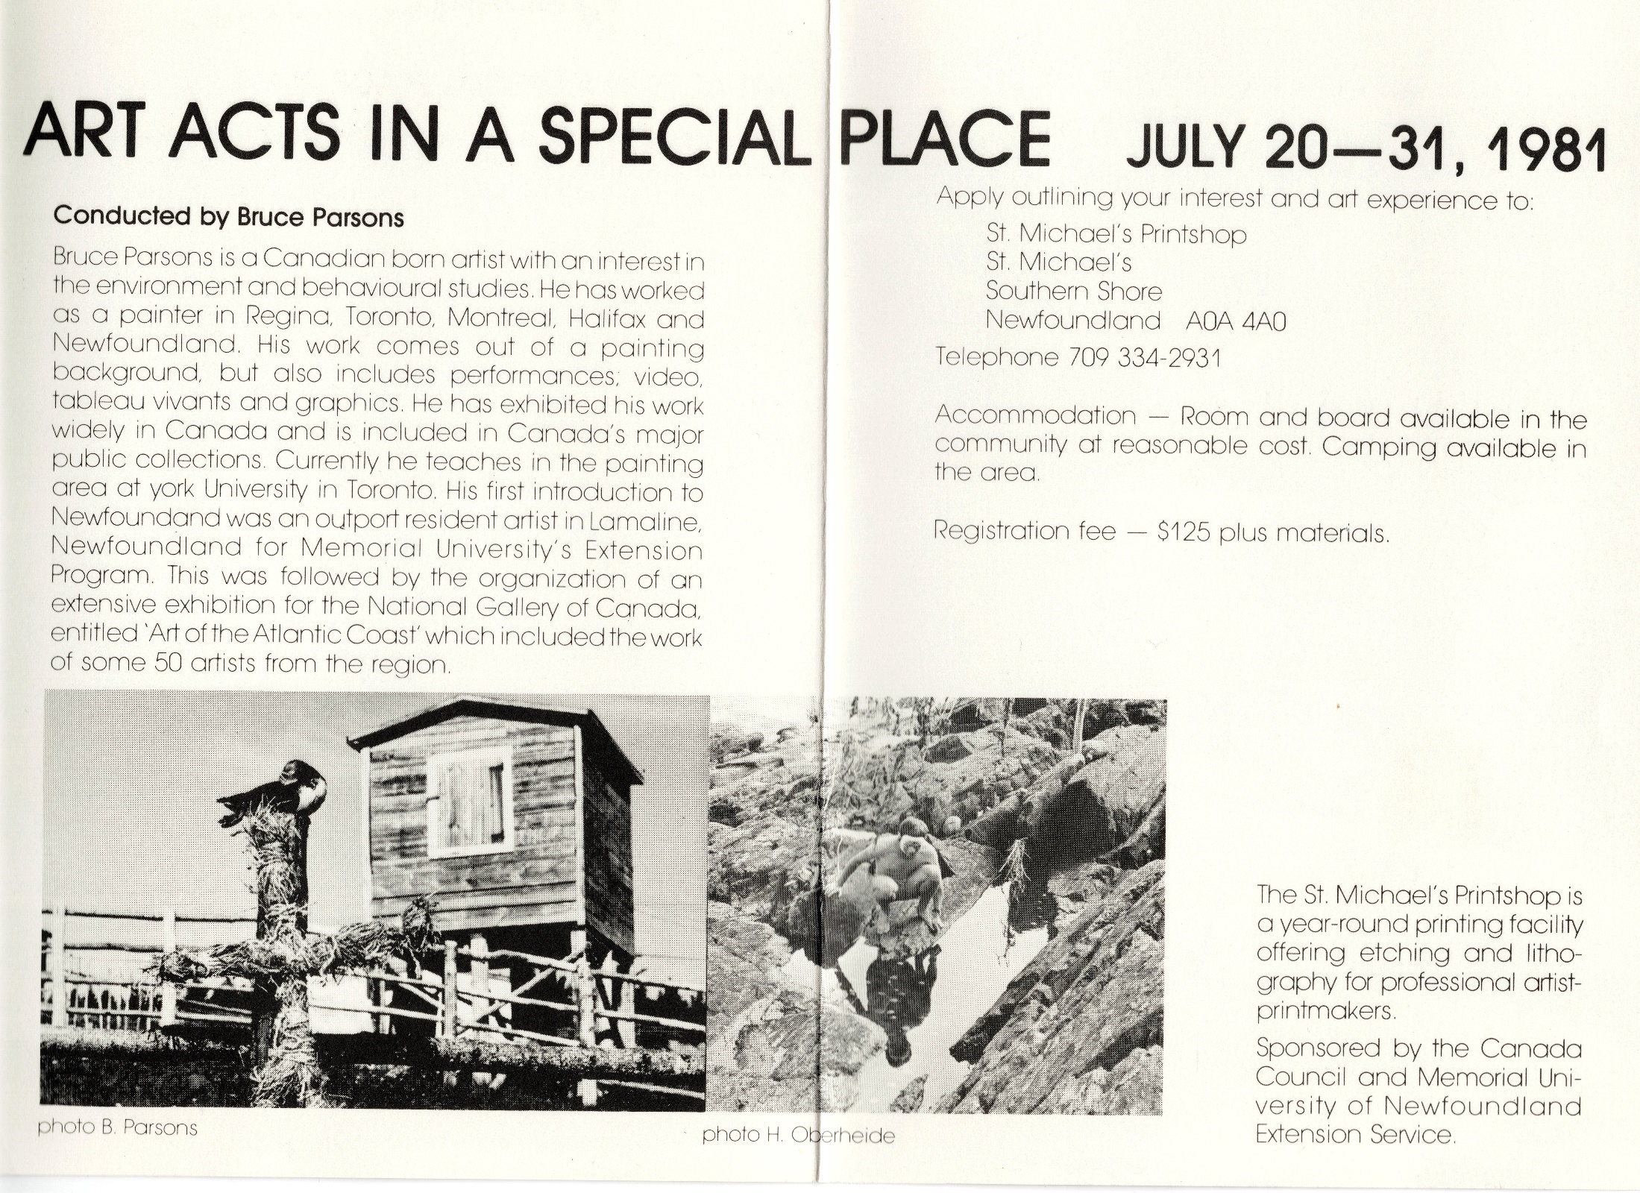

Slide 14
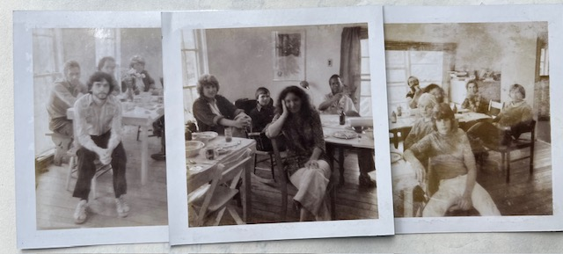
Bruce Parsons, Workshop Leader

Slide 15
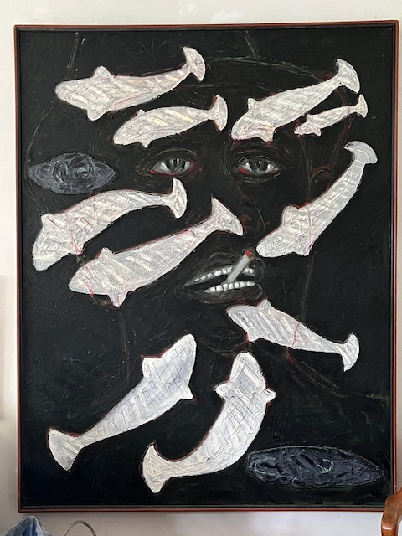

Slide 16
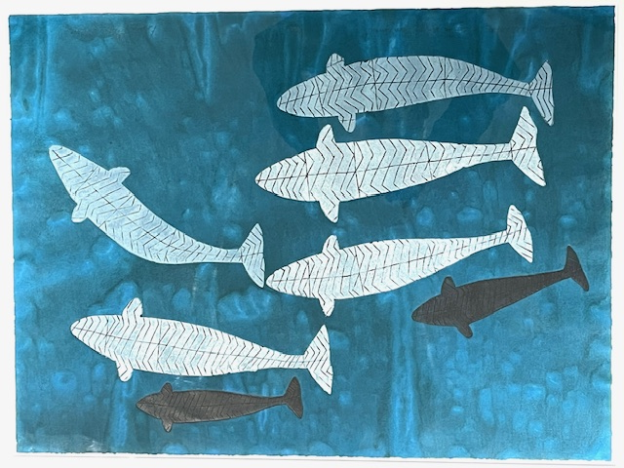

Slide 17
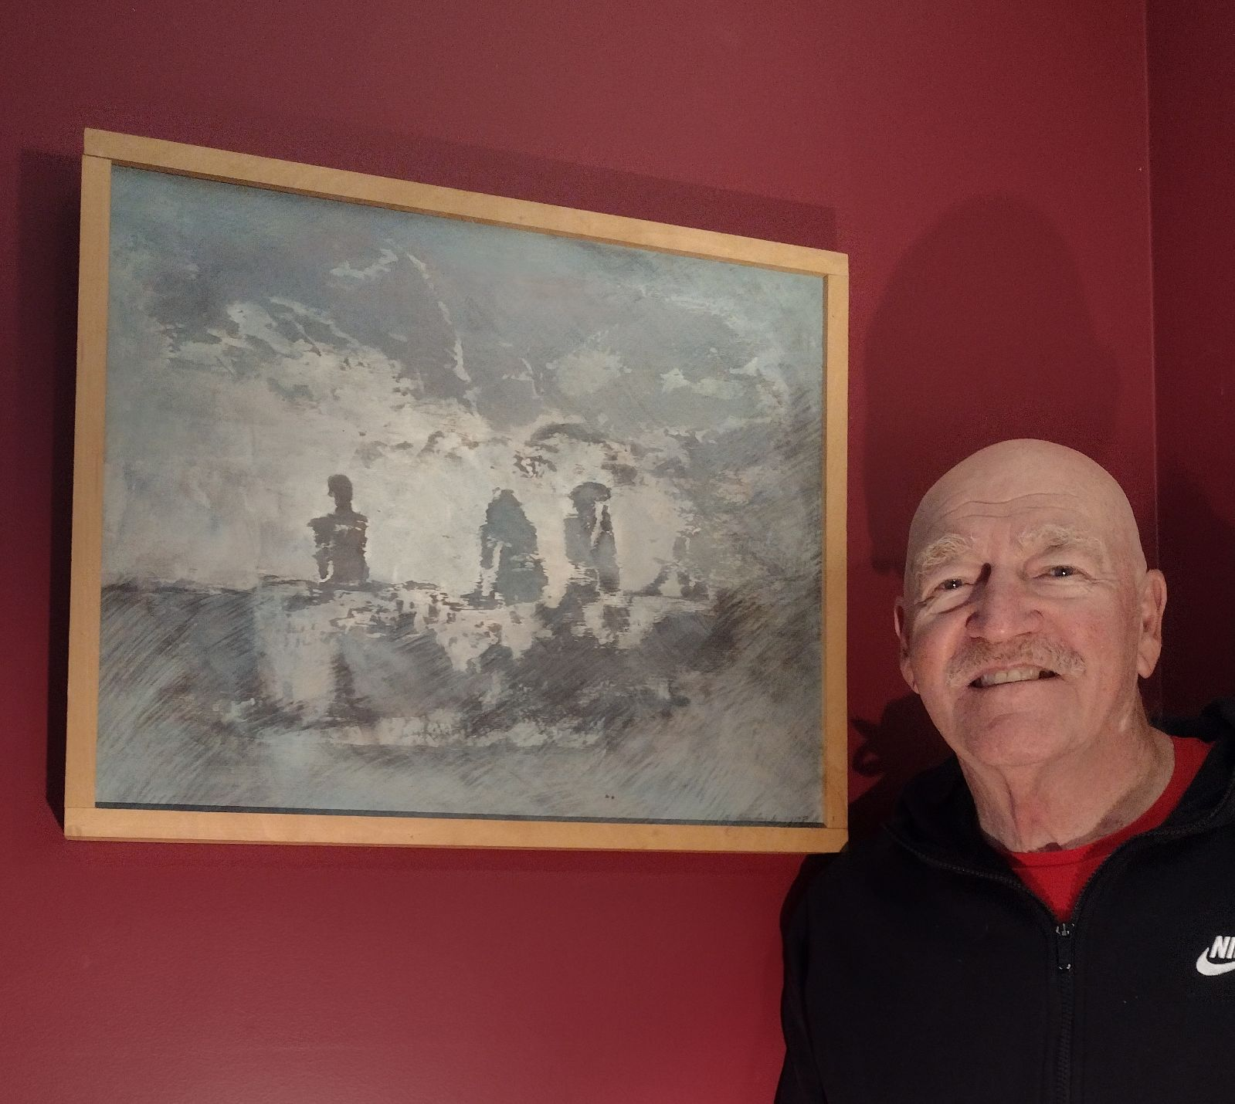
Ian Emerson, biological consultant,
Art and the Environment 1980

Slide 18
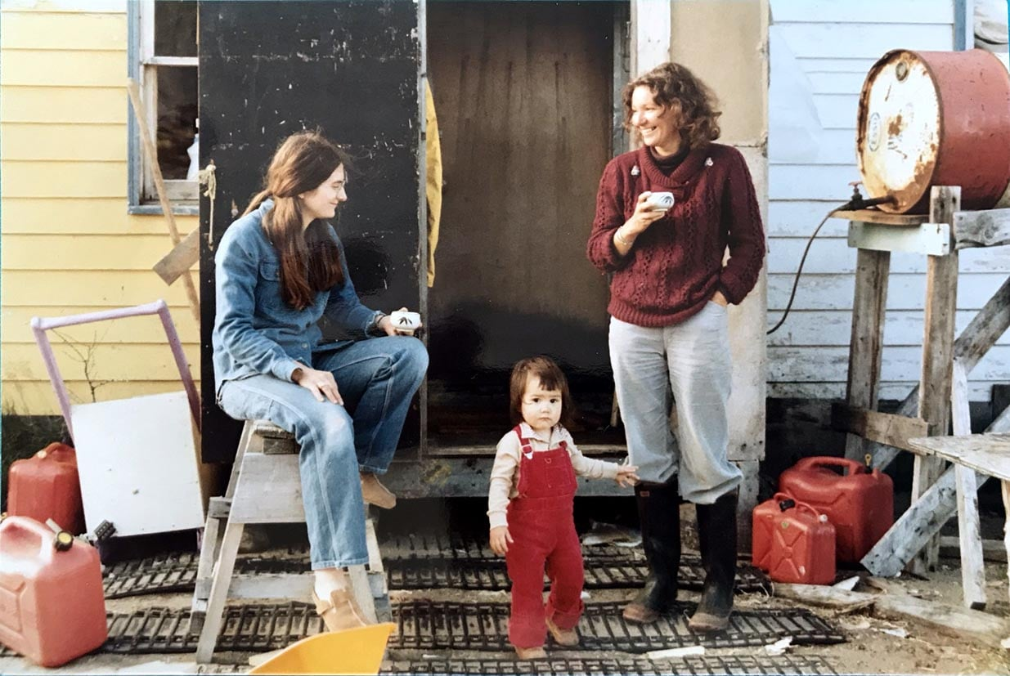
Otis Tamasauskas – In Memory of Heidi
Photo – W. Ritchie

Slide 19
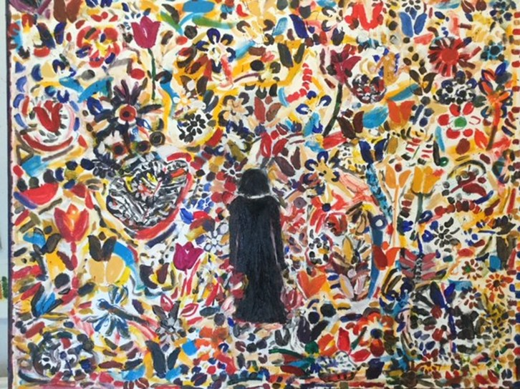
Memories from Catherine Wright
Figure in the Garden

Slide 20
Memories of Heidi and the Printshop
William (Bill) Ritchie

Slide 21
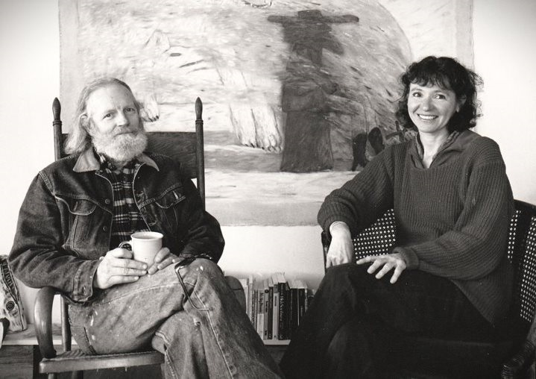
40 Years of Life and Art with Heidi by Gaylen Hansen

Slide 22
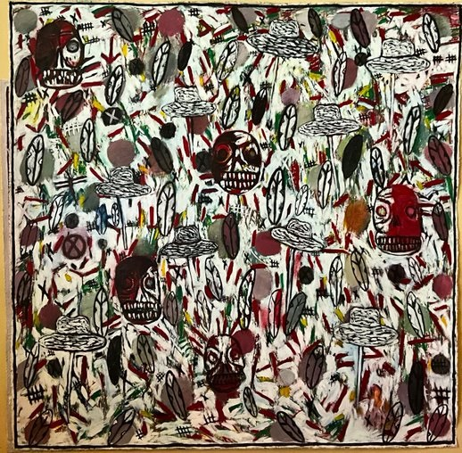

Slide 23
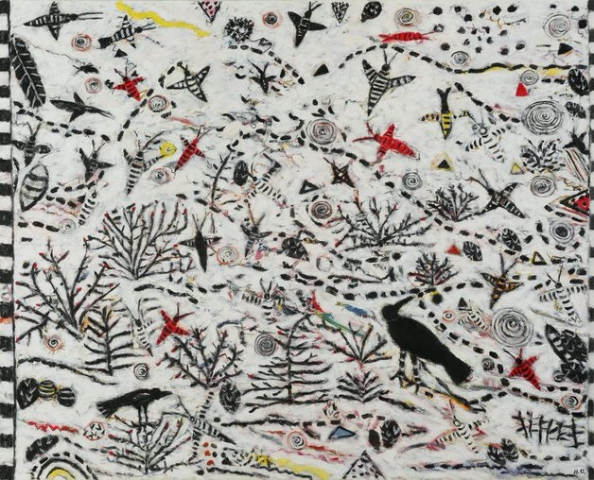

Slide 24
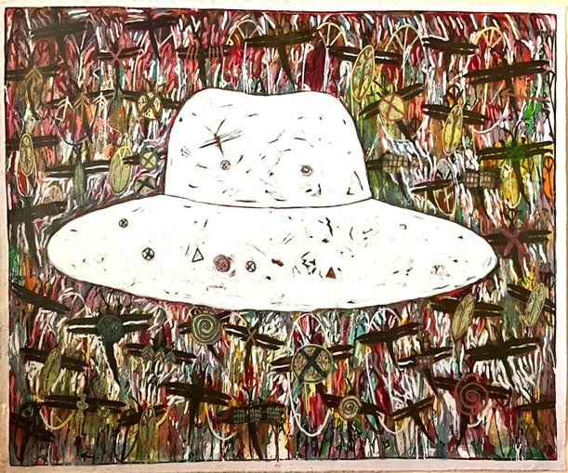

Slide 25
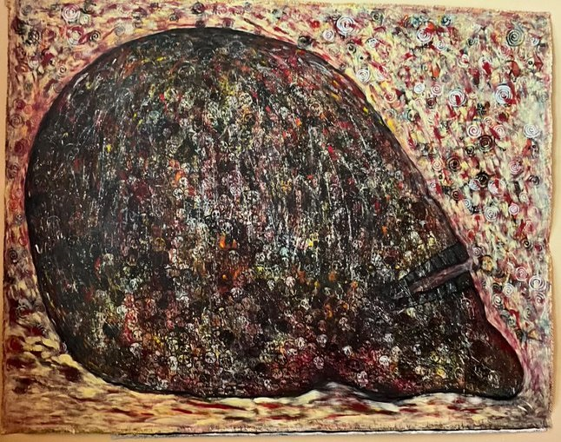

Slide 26
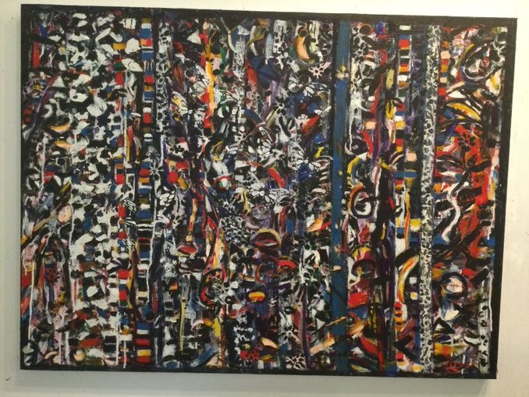

Slide 27
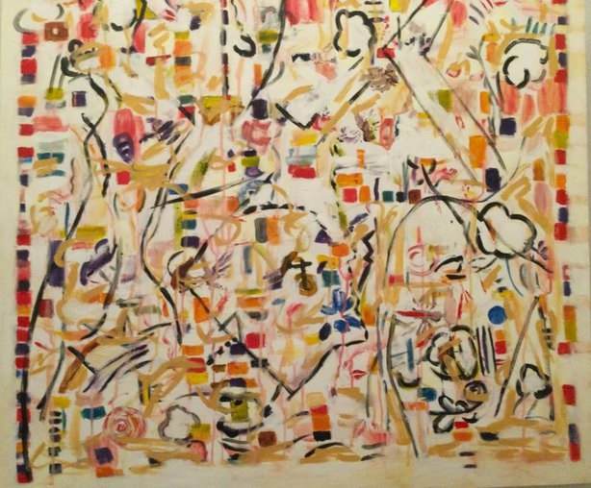

Slide 28
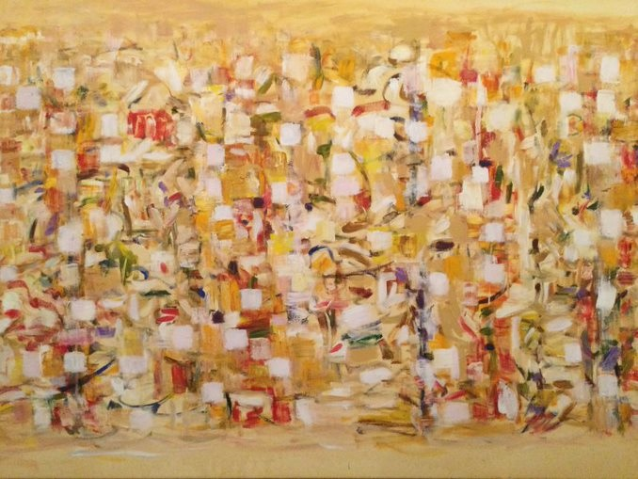

Slide 29
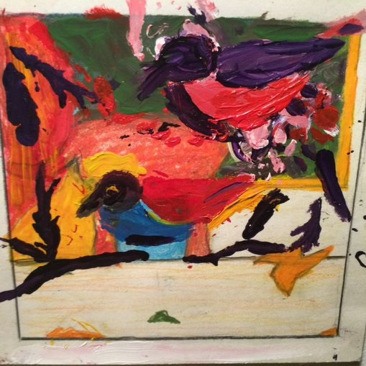

Slide 30
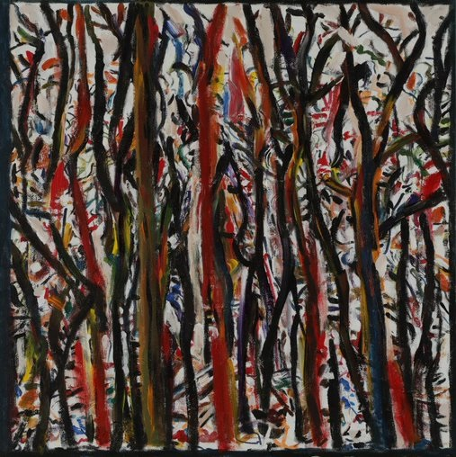

Slide 31
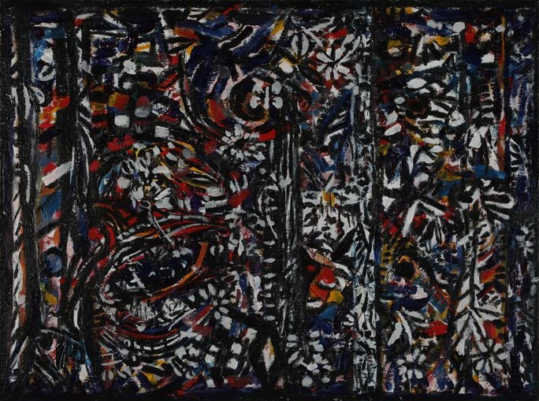

Slide 32
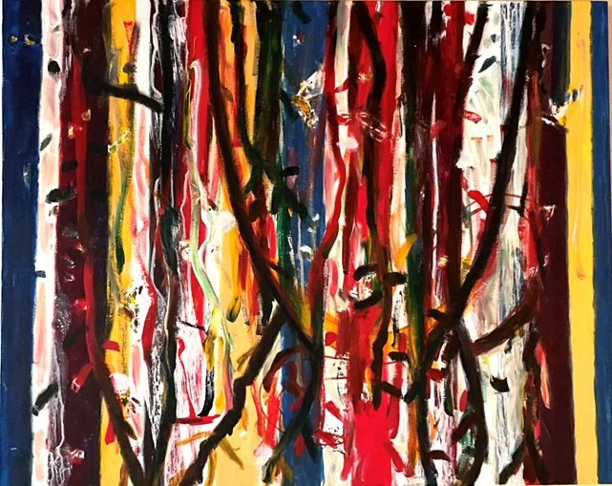

Slide 33
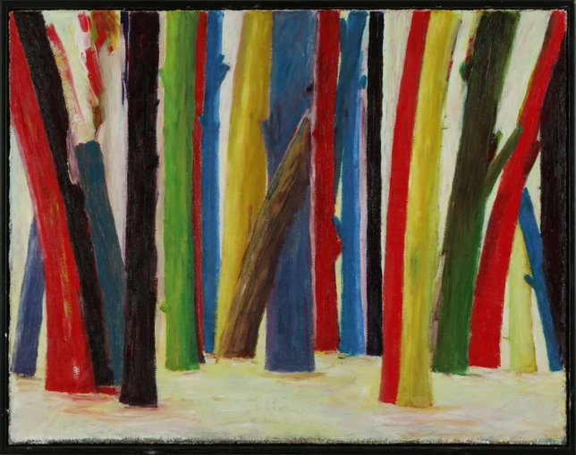

Slide 34
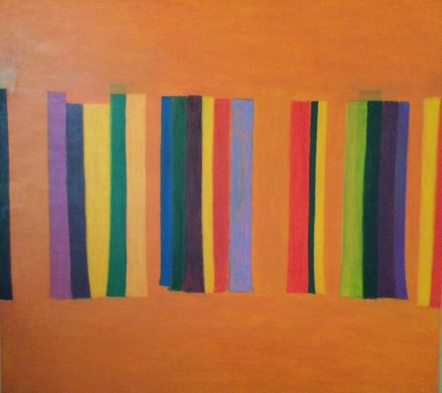

Slide 35
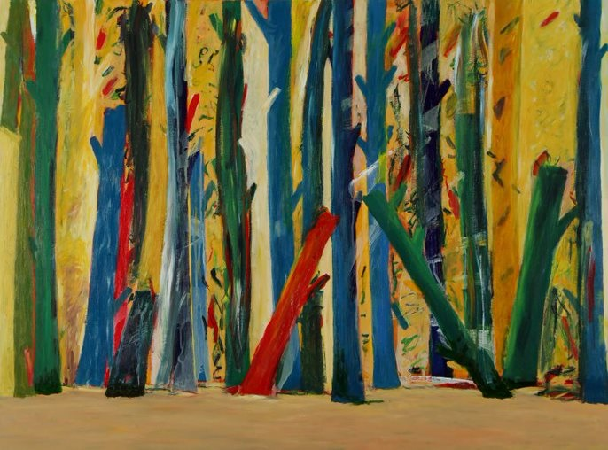

Slide 36
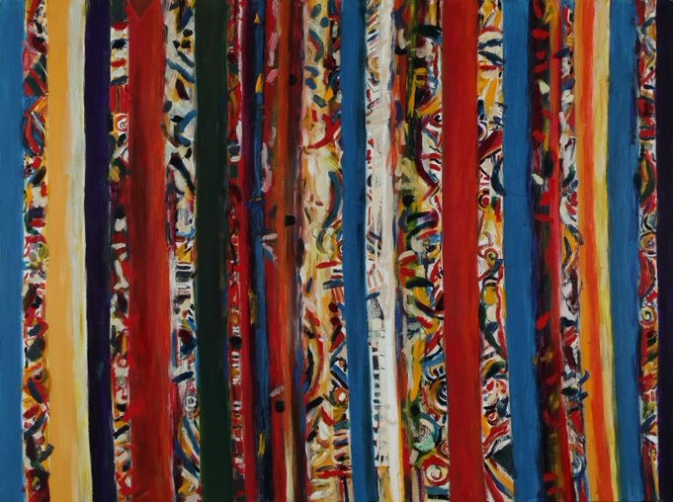

Slide 37
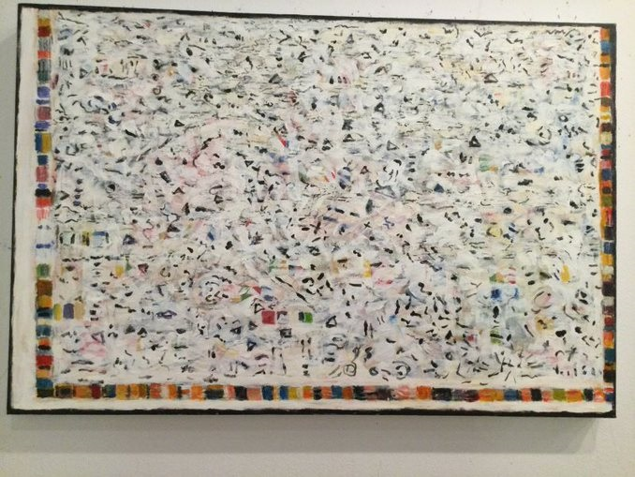

Slide 39
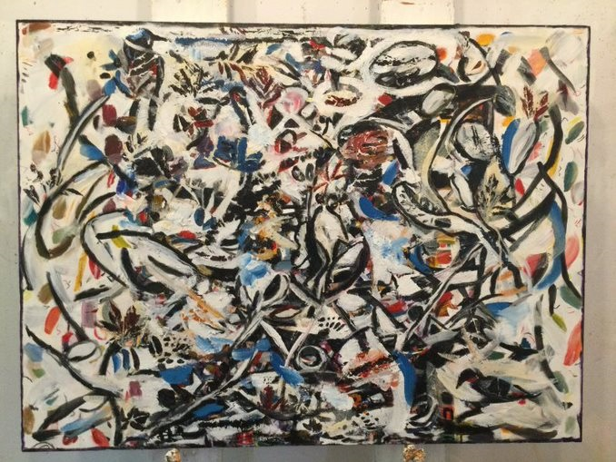

Slide 40
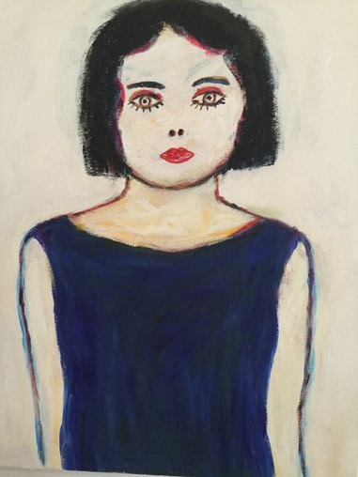
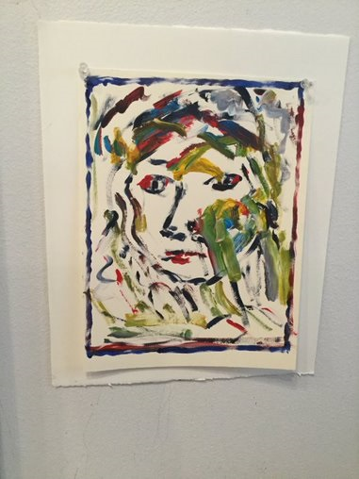
Self-Portraits

Slide 41
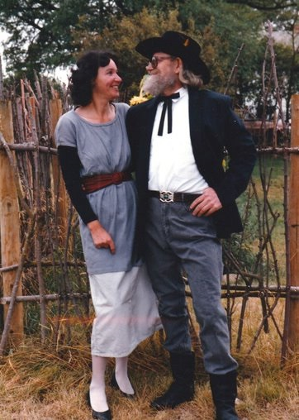
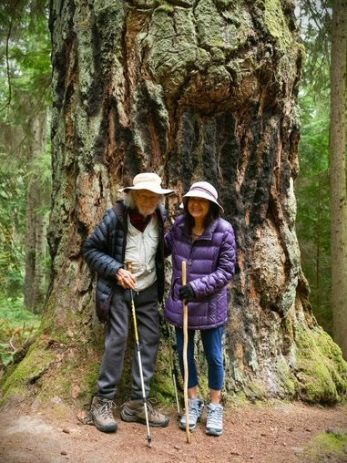

Slide 42
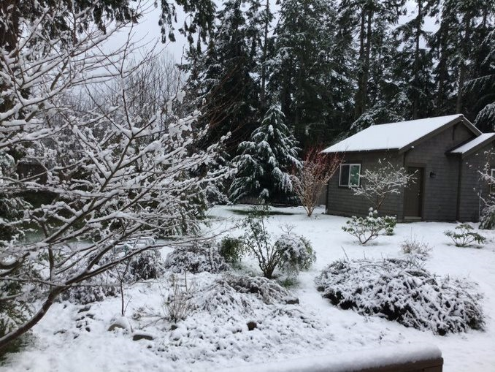
Heidi’s Studio on Whidbey Island

Slide 43
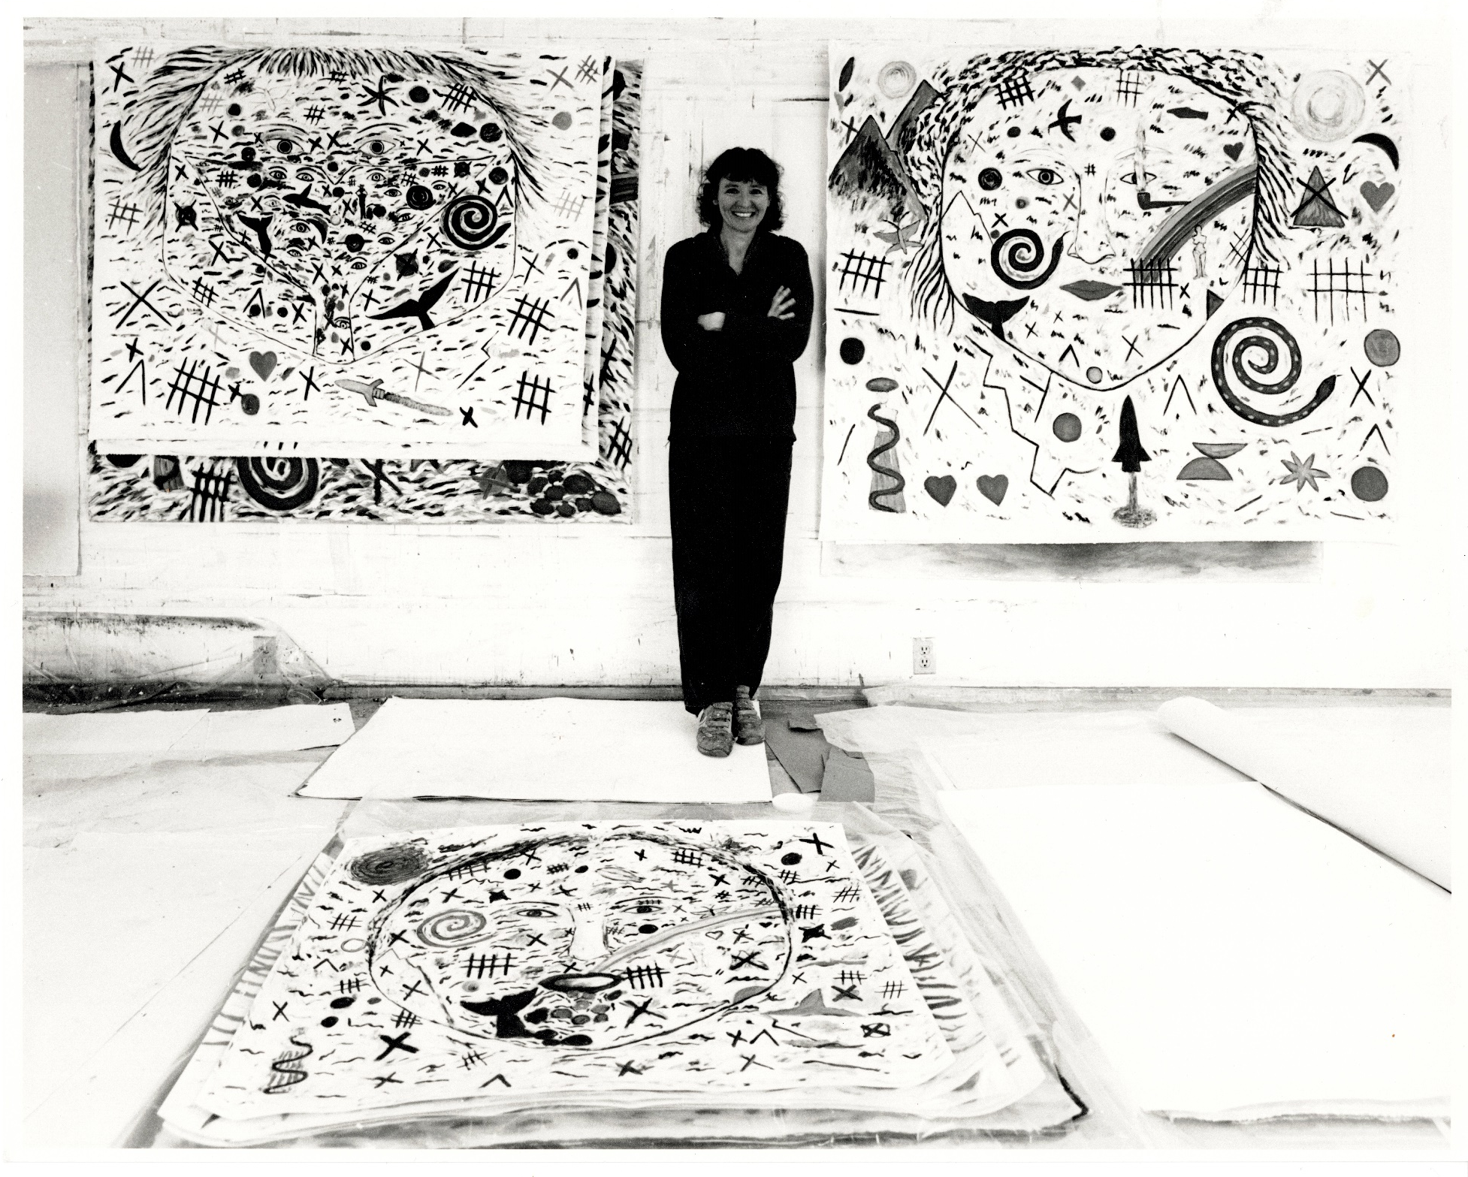
Photo Credit: Gordon Brown

Slide 44
Closing Remarks from Christeen Francis,
Executive Director, St. Michael’s Printshop
The Legacy of Heidi Oberheide
and
Celebration of the 50th Anniversary of
St. Michael’s Printshop

Slide 45
